Slide 1


MIE 465
Yelp Restaurant
Recommendation
Prepared by Team 5:
Fan Jia, Huiqing Lu, Jiayue Niu, Xiarui Xie
Notes:
Good afternoon, we are group 5 with members Fan, Huiqing, Jiayue, and Xiarui.
Today we are here to present our project Yelp restaurant recommendation. I will start with some background information.

Slide 2



Background - Yelp
Background
Problem Statement
Data Sources
EDA
EDA
Collaborative Filtering
Collaborative Filtering
Content-based Filtering
Content-based Filtering
Model Comparison
Model Comparison
Future Work
Hybrid Model
Conclusion
Collects and displays reviews of local businesses
Monthly average of 102 million users with in total over 177 million reviews as of Q4, 2018 [1]
Notes:
Yelp is a free platform that collects and displays reviews of local businesses such as boutiques, restaurants, hair salons and etc.
It has over 100 million monthly users and has collected almost 180 million reviews. Our project is focused on the restaurant reviews.

Slide 3



Problem Statement
Background
Problem Statement
Data Sources
EDA
Collaborative Filtering
Content-based Filtering
Model Comparison
Hybrid Model
Conclusion
How can we discover restaurant we would like?
Personalized recommendation system by predicting rating
Notes:
Nowadays, more and more people choose to eat outside instead of cooking at home. The question is how can we discover restaurants that we would like? To answer this question, the team decided to build a personalized recommendation system by predicting user ratings

Slide 4
Data Sources
Provided by Yelp website www.yelp.com/dataset
Background
Problem Statement
Data Sources
EDA
Collaborative Filtering
Content-based Filtering
Model Comparison
Hybrid Model
Conclusion
Business
Business ID
Average rating
# of reviews received
Business attributes
Food categories
Review
Review ID
User ID
Business ID
Rating
Review date
User
User ID
Name
# of reviews given
Average rating given
Notes:
From the Yelp open datasets, we selected business, review, and user datasets to look at. We listed here all the attributes we used from each dataset.
The most important attributes are rating, business attributes and food categories
Business attribute: price, quality, alcohol, pet allowed
Food category: fast food, dessert, american, pizza etc.

Slide 5
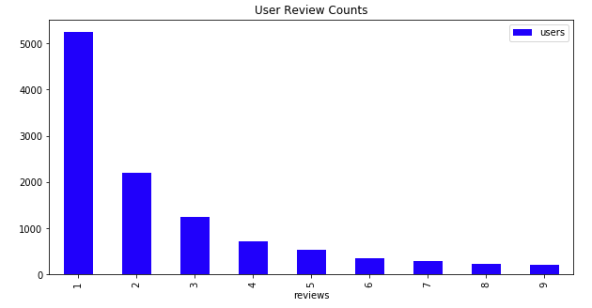
Exploratory Data Analysis (EDA)
Background
Problem Statement
Data Sources
EDA
Collaborative Filtering
Content-based Filtering
Model Comparison
Hybrid Model
Conclusion
Picked Toronto data
Filtered out users with less than 20 reviews
# of Reviews | # of Restaurants | # of Users
45,047 | 1,798 | 12,039
# of Reviews | # of Restaurants | # of Users
8,632 | 1,395 | 263
User review counts
 | User Profile |  | Restaurant Profile |  | Review Profile
 | Avg. Reviews | Avg. Stars | Avg. Reviews | Avg. Stars | Avg. Stars
Mean | 32.8 | 3.48 | 6.19 | 3.31 | 3.46
# of users
# of reviews
Notes:
Since we are living in Toronto, we picked Toronto data. However, we found that more than half of the users only left one review. In order to build better models, we decided to filtered out users with less than 20 reviews. This leaves us with about 8 thousand reviews from 260 users on 14 hundred restaurants

Slide 6
Prepare Matrices
Background
Problem Statement
Data Sources
EDA
Collaborative Filtering
Content-based Filtering
Model Comparison
Hybrid Model
Conclusion
Built two similarity-based recommender systems using cosine similarity (the example here is user-user similarity)
Arranged the data into a rating matrix
 | Restaurant 1 | Restaurant 2
User 1 | 5 | 1
User 2 | 1 | 5
Notes:
Using CF concepts, similarity based models were created with cosine similarity measures.
We first rearranged our data. For example, user1 gives 5 stars to restaurant1. Assign 0 if the rating is unknown.

Slide 7
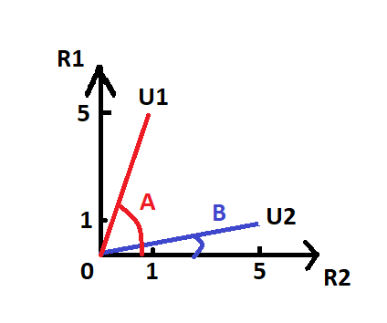

Cosine Similarity and Predict
Background
Problem Statement
Data Sources
EDA
Collaborative Filtering
Content-based Filtering
Model Comparison
Hybrid Model
Conclusion
Predict ratings
using cosine similarity:
Notes:
We plotted rating vector for 2 users to 2 restaurants. Cosine similarity measures the angle between vector and axis.
Then models will predict ratings based on others ratings and similarity.

Slide 8

Introduce RMSE for Evaluation
Background
Problem Statement
Data Sources
EDA
Collaborative Filtering
Content-based Filtering
Model Comparison
Hybrid Model
Conclusion
 |  | Predicted Rating | True Rating | Difference
U1 | R3 | 5 | 1 | 4
U1 | R4 | 3 | 3 | 0
U1 | R5 | 4 | 5 | -1
Notes:
After getting results, Root mean squared error is used for evaluation. Here is an example.
First, get all the error values, then square and take average. At last, take root.
For data ranges from 1-5, we are aiming at most rmse=1.

Slide 9


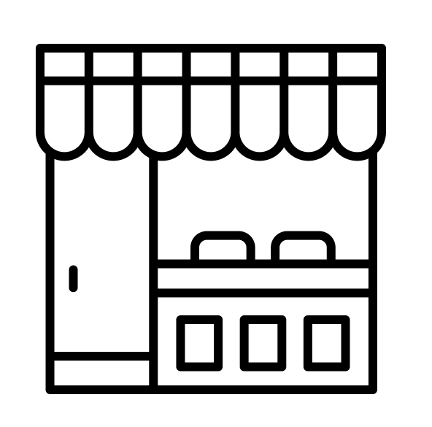
Feature Selection
Background
Problem Statement
Data Sources
EDA
Collaborative Filtering
Content-based Filtering
Model Comparison
Hybrid Model
Conclusion
185 original features 34 final features
Region
Food Type
Occasion
Notes:
In addition, we also tried content-based filtering, the first step is to cluster more than 1000 restaurant into groups.
As in the original dataset, each restaurant has more than 180 features, we selected 34 important features manually and those final features are mainly describing the restaurant by its region, food type and occasion.,

Slide 10

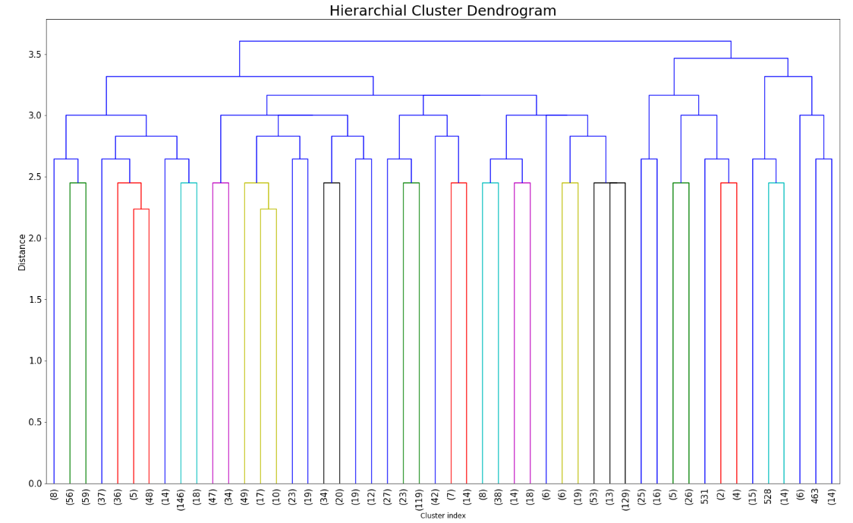
Hierarchical Clustering
Background
Problem Statement
Data Sources
EDA
Collaborative Filtering
Content-based Filtering
Model Comparison
Hybrid Model
Conclusion
8 Clusters Selected
Distance
Notes:
Then we conducted hierarchical clustering based on the 34 features, using the euclidean distance and complete rule.
And we get the cluster dendrogram.
All the clusters looks pretty even-distributed. We selected the cut off point at distance 3.1 and got 8 clusters for our restaurants.

Slide 11


Random Forest Model
Background
Problem Statement
Data Sources
EDA
Collaborative Filtering
Content-based Filtering
Model Comparison
Hybrid Model
Conclusion
Input features include:
Restaurant: cluster #, restaurant review count, average stars of restaurant
User: user review count, user average rating
Notes:
After getting the cluster # for each restaurant, we decide to build a random forest model to predict the users’ rating for restaurants.
The input features includes cluster #, review count, average stars for restaurant
For users, we included user review count and user average rating

Slide 12

Result for Random Forest Model
Background
Problem Statement
Data Sources
EDA
Collaborative Filtering
Content-based Filtering
Model Comparison
Hybrid Model
Conclusion
5 fold cross validation & grid search
Best Model: 200 trees & Max depth = 6
RMSE: 0.87
Notes:
Just like the previous models, we used 80% data for training and 20% of data for testing.
To prevent overfitting while getting the best model, we applied 5-fold cross validation and grid search.
Our best random forest model turns out to consist of 200 trees with max depth of 6.
And the RMSE for this model is 0.87

Slide 13
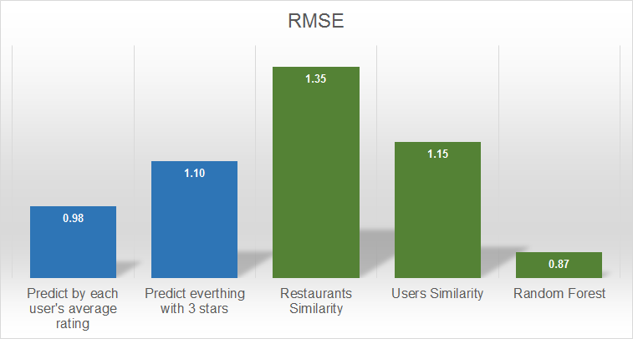
Comparison of Model Performance
Background
Problem Statement
Data Sources
EDA
Collaborative Filtering
Content-based Filtering
Model Comparison
Hybrid Model
Conclusion
Pseudo models
Our models
Best model
Notes:
Here is a comparison between two pseudo models and our models. Random forest has the best performance, but our collaborative filtering models are not looking good. We hence wonder if we can boost the performance if we combine the collaborative filtering and random forest together.

Slide 14

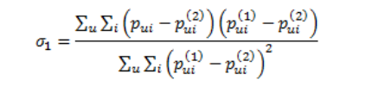
Weighted Hybrid Model
Background
Problem Statement
Data Sources
EDA
Collaborative Filtering
Content-based Filtering
Model Comparison
Hybrid Model
Conclusion
Users Similarity + Random Forest
Predictions from the two models are used as variables into a linear combination [2]
Hybrid model prediction
Weights assigned to models
Notes:
Based on our research, we found this weighted hybrid model. We are going to compute a weighted linear combination of users similarity and random forest.
Their predictions are used as inputs. And the weight assigned to each model is computed with the actual user ratings and predictions from the input models.

Slide 15
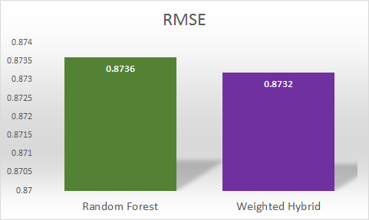

Results for Weighted Hybrid Model
Background
Problem Statement
Data Sources
EDA
Collaborative Filtering
Content-based Filtering
Model Comparison
Hybrid Model
Conclusion
Slight improvement in model performance
Random Forest Model RMSE: 0.8736
Weighted Hybrid Model RMSE: 0.8732
Notes:
After developing the weighted hybrid model, we compared its performance with the previous best model, random forest, and there is a slight improvement in performance.
Now the hybrid model is our new champion, and it has the advantage of combining collaborative and content-based filtering for a more balanced prediction.

Slide 16

Conclusion
Background
Background
Problem Statement
Problem Statement
Data Sources
Data Sources
EDA
EDA
Collaborative Filtering
Collaborative Filtering
Content-based Filtering
Content-based Filtering
Model Comparison
Model Comparison
Hybrid Model
Hybrid Model
Conclusion
Conclusion
Optimal model:
Weighted Hybrid Model
Recommend restaurants with the highest predicted ratings
Notes:
In conclusion, we use the weighted hybrid model to better predict user’s ratings for different restaurants, and recommend restaurants with the highest predicted ratings to users.
This personalized recommendation system can be continuously updated and improved as the users provide more inputs to yelp.
And Thank you

Slide 17
References
[1]. "About Us | Yelp", Yelp, 2019. [Online]. Available: https://www.yelp.com/about. [Accessed: 01- Feb- 2019].
[2]. Lin W, Li Y, Feng S, and Wang Y 2014 The optimization of weights in weighted hybrid recommendation algorithm Proc. of the 2014 IEEE/ACIS 13th International Conference on Computer and Information Science (ICIS) pp 415-18

Slide 18
Thanks!
Any questions?

